Slide 1
HUMAN COMPUTER INTERACTION (M23DES212) School of CSA /MCA- IInd sem
Dr. Ambili P S

Slide 2
Unit- iiI contents
User Experience Requirements - Analysis within the Usability Engineering Lifecycle, Task Analysis, Contextual Design, Grounded Theory Method in Human Computer Interaction and Computer Supported Cooperative Work, An Ethnographic Approach to Design

Slide 3
introduction
User Interfaces (UIs) serve as the bridge between users and technology.
Good window and control design can improve efficiency and user satisfaction.

Slide 4
Windows – New and Navigation Schemes
Primary windows are the main interface.
• Secondary windows include pop-ups and dialogs.
• Navigation schemes like tabbed interfaces or wizard steps improve user flow.
• Good navigation reduces user confusion and improves task completion time.

Slide 5
Window Selection Criteria
• Select modal windows when immediate user attention is needed.
Modal windows are UI elements that appear on top of the main interface and require users to interact with them before they can return to the underlying content. They temporarily block interaction with the main window until the user completes an action
• Use modeless windows for multitasking.
• Match window type to task complexity and available screen space.
• Keep consistency in layout and hierarchy.

Slide 6
Device-based and Screen-based Controls
• Device-based controls (mouse, touch, keyboard) determine how users interact physically.
• Screen-based controls (buttons, sliders, text boxes) provide visual elements.
• Controls must respond smoothly to different devices and contexts.

Slide 7
Designing Effective Controls
• Frequently used controls should be large and prominent.
• Group related controls logically.
• Provide adequate spacing to avoid mis-clicks.
• Always offer undo/redo options for errors.

Slide 8
Components – Text and Messages
• Use concise, actionable text for instructions.
• Feedback messages should be immediate and clear.
• Avoid technical jargon; tailor the tone to the user group.
• Highlight errors clearly with suggestions.

Slide 9
Components – Icons and Cursors
• Icons should be simple and self-explanatory.
• Use consistent visual style across all icons.
• Cursors give visual cues about the system’s state (e.g., loading, input).
• Provide tooltip text for icons to enhance usability.

Slide 10
Use of Multimedia
• Use animations to illustrate transitions or state changes.
• Audio can be used for alerts but must be optional.
• Video tutorials enhance onboarding.
• Avoid excessive multimedia to reduce load time and distraction.

Slide 11
Use of Colors in UI Design
• Color psychology is a powerful tool in UI/UX design.
• Color guides attention and denotes meaning (e.g., red = error).
• Use brand colors consistently for identity.
• Maintain contrast between text and background for readability.
•

Slide 12
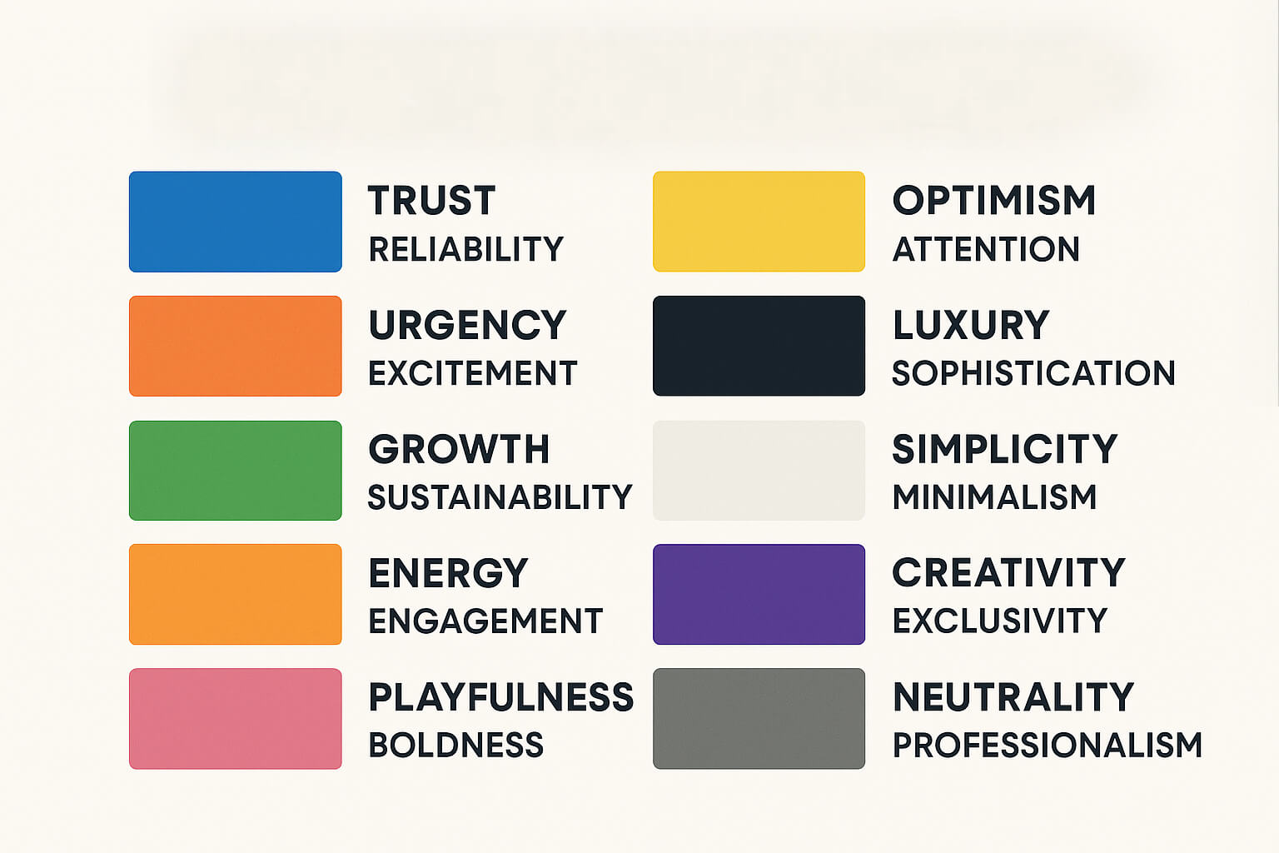
Use of Colors in UI Design
•
A quick guide to what each color communicates in branding and UI.

Slide 13



Use of Colors in UI Design
Color | Meaning & Impact |  | Example Brands
Blue | Trust, reliability, professionalism |  | Facebook, LinkedIn, Stripe
Red | Urgency, excitement, power |  | YouTube, Netflix, HubSpot
Green | Growth, balance, sustainability |  | Whole Foods
Yellow | Optimism, attention, creativity |  | Snapchat, Bumble, IKEA
Black | Luxury, sophistication, minimalism |  | Apple, Tesla, Chanel
White | Simplicity, clarity, modernity |  | Google, Airbnb, Tesla
Purple | Creativity, exclusivity, premium feel |  | Twitch, Adobe, Cadbury
Orange | Energy, friendliness, engagement |  | Duolingo, Fanta, Harley-Davidson
Pink | Playfulness, boldness, uniqueness |  | T-Mobile, Canva, Barbie
Gray | Neutrality, professionalism, tech |  | Apple, Salesforce, Mercedes-Benz
•

Slide 14
Choosing Colors – Guidelines
• Use color schemes that support color-blind users.
• Avoid using only color to convey information.
• Test color contrast for visibility on different screens.
• Harmonize colors using analogous or complementary palettes.

Slide 15
Problems in Using Colors
• Poor contrast can cause readability issues.
• Misuse of bright or flashing colors can cause eye strain.
• Cultural interpretations of colors vary — red may signal danger in one culture, but prosperity in another.

Slide 16
User Experience Requirements
User experience (UX) refers to how a user interacts with and experiences a product, system, or service, encompassing their perceptions, emotions, and responses throughout the interaction.
As web capabilities have increased, graphic design has become a key quality of the UX.
In the case of e-Commerce websites, a relatively new quality of the UX design has emerged: persuasiveness.
Persuasiveness in UX is the intentional use of design, content, and interaction elements to guide, influence, or motivate users toward certain behaviors or decisions, often aligned with business goals.
Any e-Commerce designer or developer needs to recognize the importance of the following five different qualities of the total website UX:
Utility , Functional integrity, Usability , Persuasiveness and Graphic design

Slide 17
Analysis within the Usability Engineering Lifecycle
Mayhew, 1999 documented a structured and systematic approach to addressing usability within the product-development process.
It consists of a set of usability engineering tasks applied in a particular order at specified points in an overall product-development lifecycle.
The overall lifecycle is cast in three phases:
Requirements Analysis
Design/Testing/Development
Installation.

Slide 18
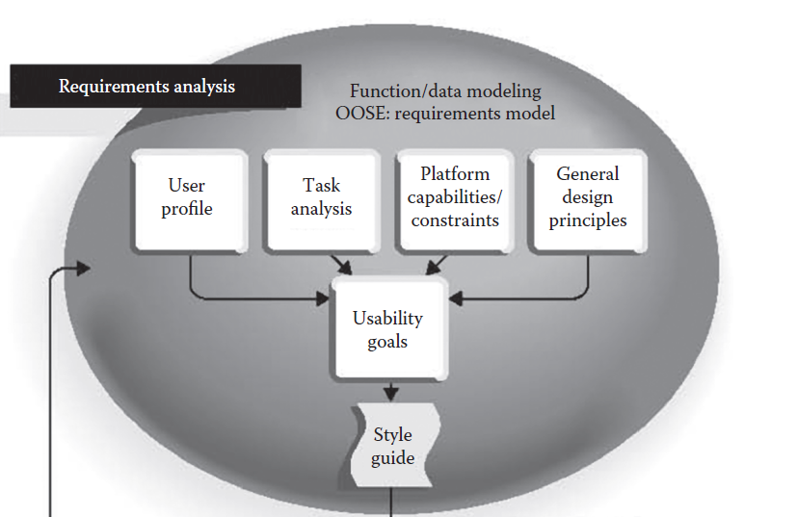
Phase 1: Requirements Analysis
The user interface capabilities and constraints (e.g., windowing, direct manipulation, screen size, color, etc.) inherent in the technology platform chosen for the product (e.g., Apple Macintosh, MS Windows, product-unique platforms) are determined and documented. These will define the scope of possibilities for user interface design.
A description of the specific user characteristics relevant to user interface design (e.g., computer literacy, expected frequency of use, level of job experience) obtained
for the intended user population. This will drive tailored user interface design decisions and identify major user categories for study in the Contextual Task Analysis task.
Specific qualitative goals reflecting usability requirements are developed, extracted from the User Profile and Contextual Task Analysis. In addition, quantitative goals (based on a subset of high-priority qualitative goals) are developed, defining minimal acceptable user performance and satisfaction criteria.
A study of users’ current
tasks, workflow patterns, and conceptual frameworks is made,
resulting in a description of current tasks and workflow, and understanding and specification of underlying user goals.

Slide 19
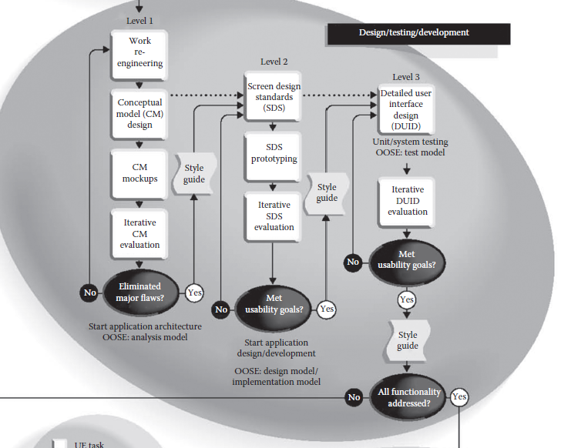
Phase 2: Design/Testing/ Development

Slide 20
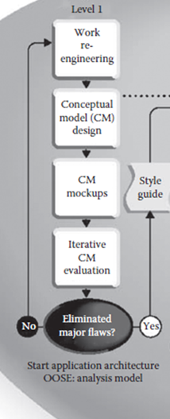
Level 1 Design (High level Design)
Based on all requirements-analysis data and the usability goals extracted from it, user tasks are redesigned at the level of organization and workflow to streamline work and exploit the capabilities of automation. No user interface design is involved in this task, just abstract organization of Work reengineering.
Conceptual model design: Based on all the previous tasks, initial high-level design alternatives are generated. At this level, navigational pathways and major displays are identified, and rules for the consistent presentation of work products, processes, and actions are established.
Conceptual model mockups: Paper-and-pencil or prototype mockups of high-level design ideas generated in the previous task are prepared, representing ideas about high-level functional organization and Conceptual Model Design.
The mockups are evaluated and modified through iterative evaluation techniques such as formal usability testing, in which real, representative end users attempt to perform real, representative tasks with minimal training and intervention, imagining that the mockups are a real product user interface.

Slide 21
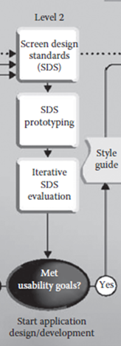
Level 2 Design (Detailed / Interface Design)
A set of product-specific standards and conventions for all aspects of detailed screen design is developed, based on any industry and/or corporate standards that have been mandated (e.g., Microsoft Windows, Apple Macintosh, etc.), the data generated in the Requirements Analysis phase, and the product-unique Conceptual Model Design arrived at during Level 1 Design.
At the end of the design/evaluate iterations in Design Levels 1 and 2, you have a validated and stabilized Conceptual Model Design, and a validated and stabilized set of standards and conventions for all aspects of detailed Screen Design.

Slide 22
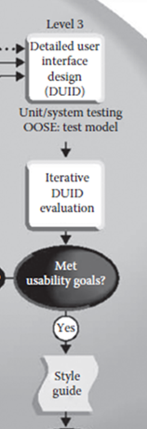
Level 3 Design (Implementation / Production Design)
Detailed design of the complete product user interface is carried out based on the re fined and validated Conceptual Model and Screen Design Standards documented in the product Style Guide.
Iterative DUID Evaluation: After the detailed UI is built and tested, it undergoes usability evaluation with actual or representative users. This is iterative, the design is tested, problems are fixed and then retested, until it meets the goals.
Once the final UI passes usability checks, it becomes part of the style guide for the product. Acts as a reference point for maintaining usability standards.
This style guide ensures: Consistency in future updates or related products.

Slide 23
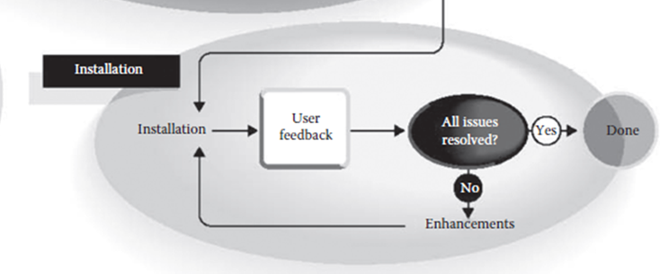
Phase 3: Installation
The product is delivered and installed in the target environment (could be software installation, hardware setup, or deployment to a server).This is the real-world launch, not just a lab test.
The loop continues until:
No significant usability or functional issues remain.
The product meets the agreed usability goals in the real-world environment.

Slide 24
ethnographic approach to design
Ethnography is a qualitative research method that involves studying people in their natural environments to understand their behaviors, needs, and interactions with products, technology, and spaces.
Ethnographic approach to design focuses on observing and participating in the daily lives of users to uncover deep insights about how they use and experience design elements within their cultural and social contexts.
This approach helps designers create user-centered, culturally sensitive, and practical solutions that truly fit the real-world needs of people.

Slide 25
ethnographic approach Vs Traditional Usability Testing
Aspect | Ethnographic Design Approach | Traditional Usability Testing
Purpose | Understand user’s real-world context, culture, and behavior | Test how easily a user can perform tasks on a product or prototype
Setting | User’s natural environment (home, workplace, public spaces) | Controlled lab or testing room
Focus | Deep insights into habits, motivations, and social factors | Performance metrics like task completion time, error rate
Method | Observation, in-context interviews, shadowing, participation | Structured tasks, observation, think-aloud protocols
Outcome | Design decisions grounded in real-life needs and constraints | Refinements to improve efficiency, usability, and interface clarity
Example | Spending a week with farmers to design an agricultural app | Bringing farmers into a lab to test a prototype app’s navigation

Slide 26
Task analysis
Task analysis means understanding users’ work.
Task analysis is a systematic process of studying the way users perform their activities to achieve specific goals, focusing on the tasks, subtasks, information needs, and environmental constraints involved.
It serves as a bridge between understanding user requirements and designing usable systems.

Slide 27
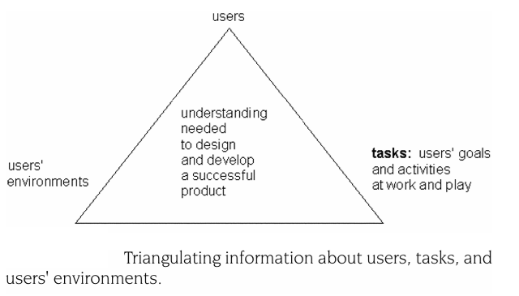
Task analysis
Task analysis goes hand in hand with understanding users (user analysis) and
understanding the users’ physical, technological, cultural, social,
and political environments (environmental analysis).

Slide 28
Four Principles That Underlie Task Analysis
Task analysis is an integral part of a broader analysis that includes understanding users and their environments.
Task analysis includes understanding users’ goals.
Although the focus, methods, granularity, and presentation of information may differ at different times, task analysis is relevant at all stages of the design and development process.
The practical reality is that task analysis for a given project depends on many factors.

Slide 29
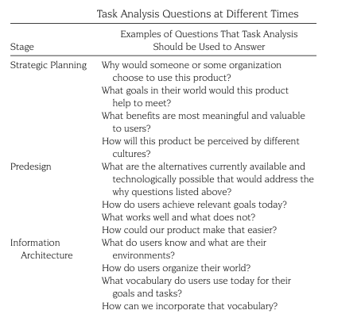

Slide 30
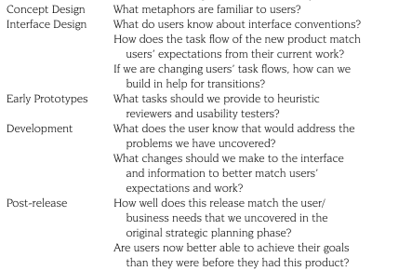

Slide 31
Types of Task Analysis
There are several task analysis methods, such as
Hierarchical Task Analysis (HTA) - which breaks down tasks into goals, operations, and plans;
Cognitive Task Analysis (CTA) - which focuses on mental processes and decision-making;
Contextual Task Analysis, which accounts for environmental, social, and organizational factors.

Slide 32
Real case Study
Consider the online flight booking process on a travel website.
The main task is purchasing a flight ticket.
Subtasks include searching for flights, comparing options, selecting dates, entering passenger details, choosing seats, adding extras, and completing payment.
Task Analysis
A task analysis here would reveal bottlenecks—for example, users abandoning the process when seat selection loads slowly or when date flexibility options are hidden.
Through this analysis, designers could streamline the interface by showing flexible date prices upfront, reducing page load times, and grouping related fields, improving both efficiency and satisfaction.

Slide 33
Grounded Theory Method
Grounded Theory Method (GTM) is presented as one of the qualitative research approaches that are particularly valuable in HCI and Computer Supported Cooperative Work (CSCW).
Instead of testing a pre-existing hypothesis, it builds theory inductively from data through systematic coding, categorization, and comparison.
Grounded Theory Methods involve the simultaneous collection and analysis of data, where each step informs and focuses the other throughout the research process.
Theories are grounded in real-world practices and contexts.
GTM helps uncover patterns of use, user needs, and interaction breakdowns.

Slide 34
Advantages of Grounded Theory Method in HCI
Theories are built from the ground up, based on actual data, not preconceived assumptions. This makes findings authentic and unbiased.
GTM does not require a fixed hypothesis at the beginning. The process can adapt as new insights emerge during data collection.
In-Depth Understanding Provides deep insights into human experiences, behaviors, and social processes.
Unlike many qualitative methods that only describe, GTM actually develops new theories that explain how and why phenomena occur.
Practical Relevance : GTM has structured steps (coding → categorization → constant comparison → theory building), which make the research process organized and transparent.

Slide 35
Grounded Theory Method in Computer Supported Cooperative Work (CSCW)
CSCW studies collaborative work practices mediated by technology (e.g., groupware, shared workspaces, virtual meetings).
These practices are complex, situated, and evolving—making GTM highly valuable.
Shows how people interact with technology collaboratively.
Applications in CSCW
Understanding how teams coordinate work across time zones.
Discovering implicit social norms in online communities.
Building theories about distributed collaboration and technology adoption.

Slide 36
Contextual Design
Contextual Design is a customer-centered design process that takes a cross-functional team from collecting data about users in the field, through interpretation and consolidation of that data, to the design of product concepts and a tested product structure.
It involves observing and interviewing users in their real work environments (contextual inquiry), modeling their workflows, consolidating findings, and then designing and prototyping systems that naturally support how people actually work.
Contextual Design → Task-focused, structured, leads directly to product design.
Ethnographic Design → Culture-focused, exploratory, provides deep understanding that guides design thinking.

Slide 37
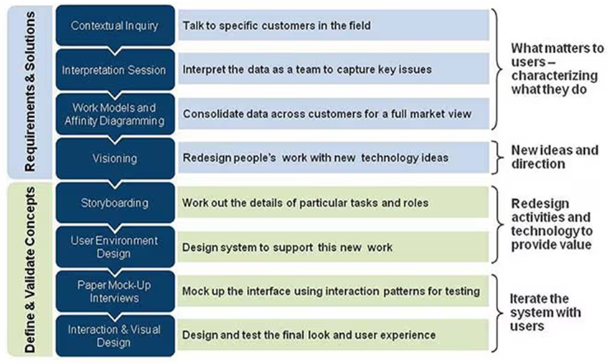
Contextual Design process

Slide 38
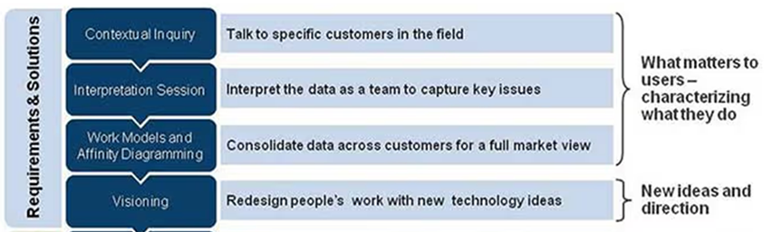
Contextual Design
Contextual Inquiry
A field data collection method where designers/researchers observe and interview users in their natural environment while they perform their real tasks.
To understand the users’ work practices, problems, goals, and context.
Raw data about user behavior, workflows, challenges, and needs are the outcomes.
Context—While people are working, gather data in the workplace and focus on the activities they are doing.

Slide 39
Contextual Design
In CD, the cross-functional design team conducts one-on one field interviews with customers in their workplaces (or life spaces) focusing on the aspects of the practice that matter for the project scope.
The number of people that should be interviewed is directly related to the project scope.
Interpretation Sessions and Work Modeling— Creating a Shared Understanding
Contextual Interviews produce large amounts of customer data, all of which must be shared among the core design team and with the larger, cross-functional team of user interface designers, engineers, documentation people, internal business users, and marketers.
After collecting field data, the design team meets to interpret and discuss findings.
Working as a distributed team: More and more companies are expecting their teams to be distributed. Distributed teams have the advantage that data can be collected from different locations with less travel, which saves time and cost.

Slide 40
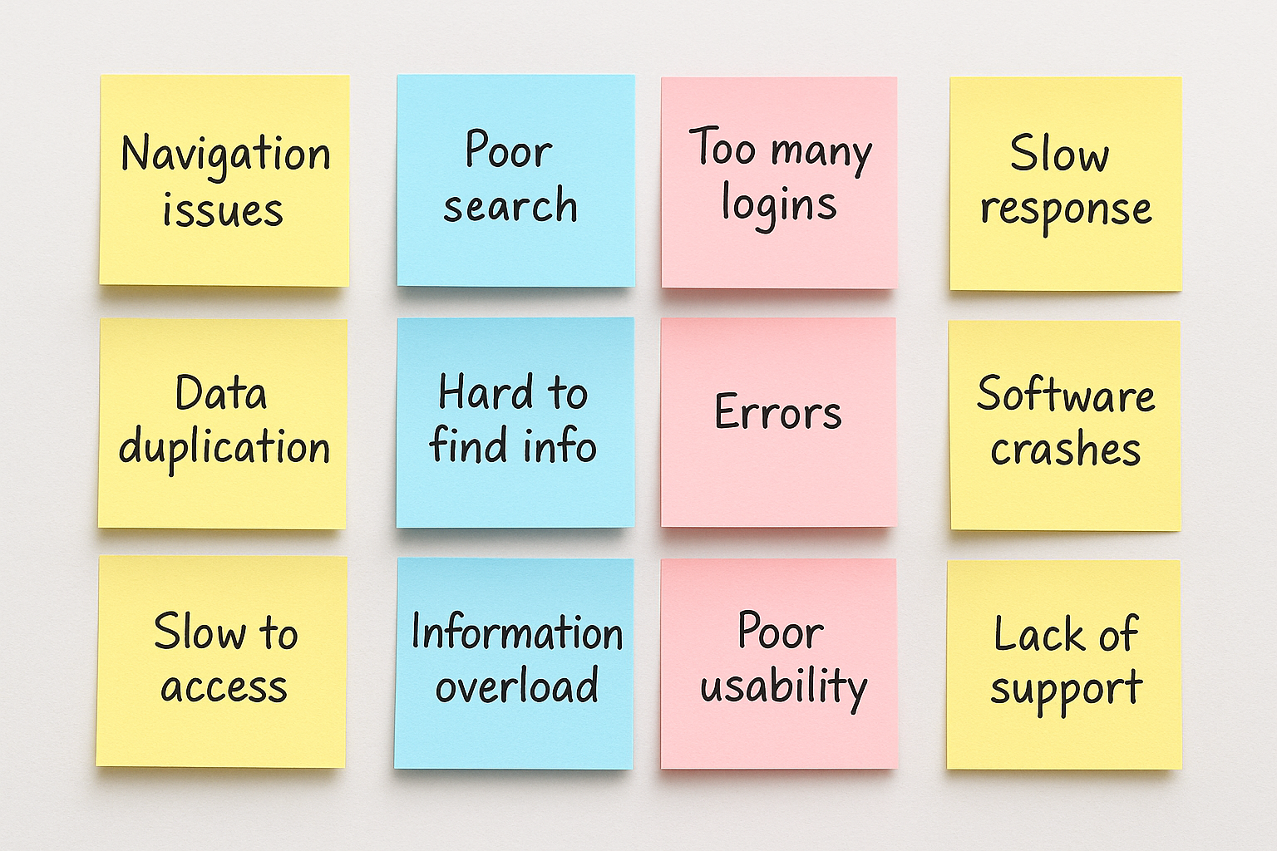
Contextual Design – work models and affinity diagrams
In CD, we consolidate the notes from the interpretation session into the affinity diagram and the sequences into consolidated sequence models to see patterns.
Affinity diagrams are hierarchical pictures of user data.
They are produced inductively by grouping similar data elements together into categories and then grouping the categories together.
The team prints the notes captured in the interpretation session onto labels that are sticky notes.

Slide 41
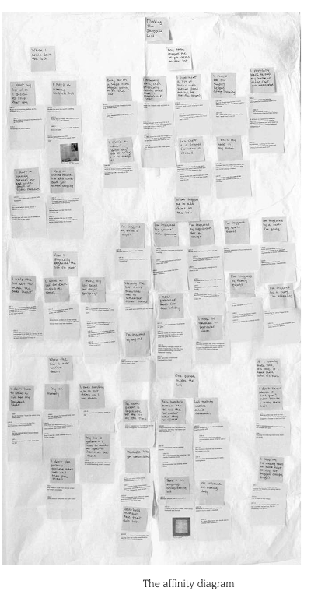
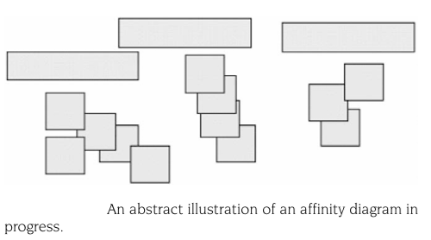
affinity diagrams
The affinity diagram brings issues and insights across all customers together into a wall-sized hierarchical diagram.

Slide 42
Visioning
Visioning is about invention.
Design of technology is first design of the story showing how manual practices, human interactions, other tools come together with your product or system to better support the whole practice. Visioning is the CD technique help teams tell that story.
Visioning is a vehicle to identify needed function in the context of the larger practice.
Visioning ensures that teams put off lower-level decisions about implementation, platform, and user interface until they have a clear picture of how their solution will fit into the whole of the practice.
During the visioning session, the team will pick a starting point and build a story of the new practice.
After a set of visions is created, the team evaluates each vision in turn, listing both the positive and negative points of the vision from the point of view of customer value, engineering effort, technical possibility, and corporate value.

Slide 43
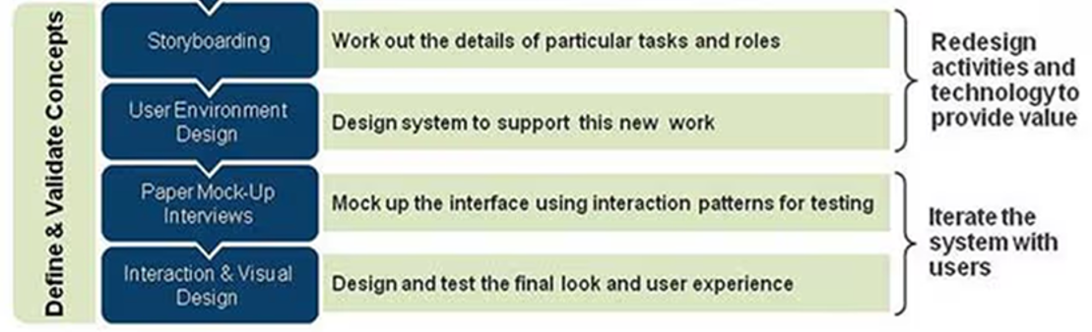
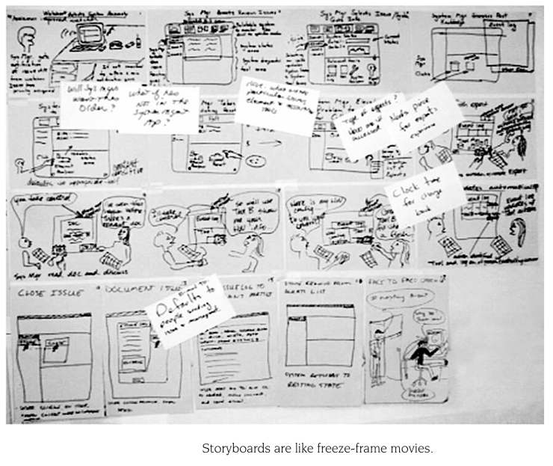
contextual design process – define and validate concepts
Storyboarding is working out the details of tasks and roles by visually mapping out user journeys. It tells a story of how users will interact with the system.

Slide 44
contextual design process – define and validate concepts
User Environment Design: Designing the system to support the actual work environment and context in which users will interact with the product.
Paper Mock-Up Interviews: Creating quick, low-cost paper prototypes of the interface and testing them with users. It helps in understanding how people would interact with the system before investing in actual development.
Interaction & Visual Design: Designing and testing the final look and feel of the product — interaction flow, colors, fonts, usability, accessibility, and overall user experience.

